Slide 1

Chips Sales Analysis: Unveiling Insights for Strategic Planning
Created by: Rupsa Chaudhuri

Slide 2

AGENDA
Introduction: Chips Sales Analysis Overview
Customer Segmentation Insights
Purchase Behavior Analysis
Brand Affinity
Customer Lifetime Value (CLV)
Churn Analysis
Seasonal Sales Analysis
SWOT Analysis
Timeline for Strategic Implementation
Investment Potential

Slide 3
Chips Sales Analysis: Introduction
Introduction: Quantium's retail analytics report offers a comprehensive analysis of customer buying habits in the chip category, utilizing transaction and behavior data to reveal insights for strategic decision-making.
Objectives: The primary objective is to deliver actionable insights to optimize marketing strategies, improve customer retention, and drive business growth by understanding the factors influencing sales and customer behavior.
Notes:
This presentation delves into the analysis of customer behavior, sales trends, and strategic recommendations in the chip sales market. By understanding key insights and leveraging data-driven strategies, investors can capitalize on growth opportunities and make informed investment decisions.

Slide 4
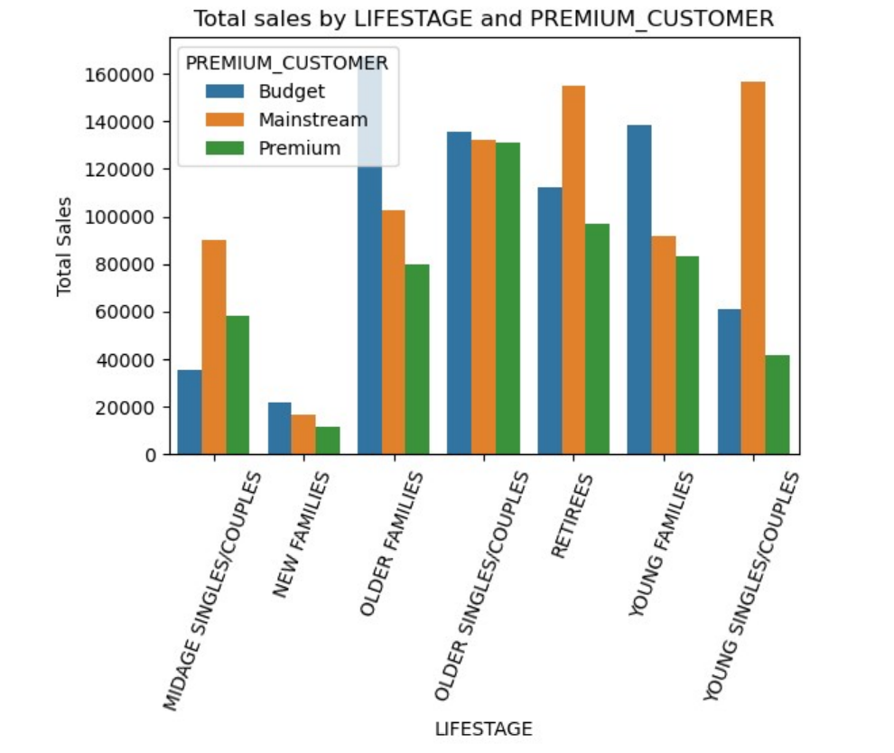
Customer Segmentation Insights
Sales Drivers
Sales in the chip market are primarily influenced by Budget-Older families, Mainstream-Young singles/couples, and Mainstream-Retirees, highlighting the importance of these customer segments in driving revenue.
Mainstream Segments
The Mainstream customer segments play a significant role in contributing to higher sales volumes, especially the Young singles/couples and Retirees categories, emphasizing the need to focus marketing efforts on these segments.
Sales Contribution
The sales contribution from these segments is significant due to a combination of a higher number of customers and increased purchase quantities per customer.
Notes:
Understanding customer segmentation is crucial in the chip sales market. By identifying key drivers of sales and the contribution of various customer segments, businesses can tailor their marketing strategies to appeal to the most profitable customer groups for enhanced revenue generation.

Slide 5
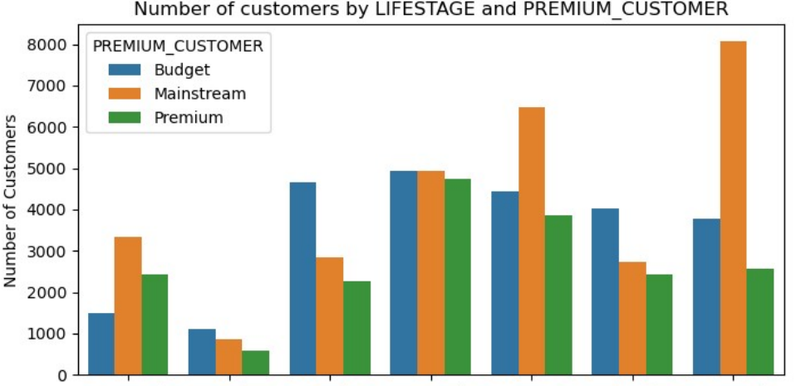
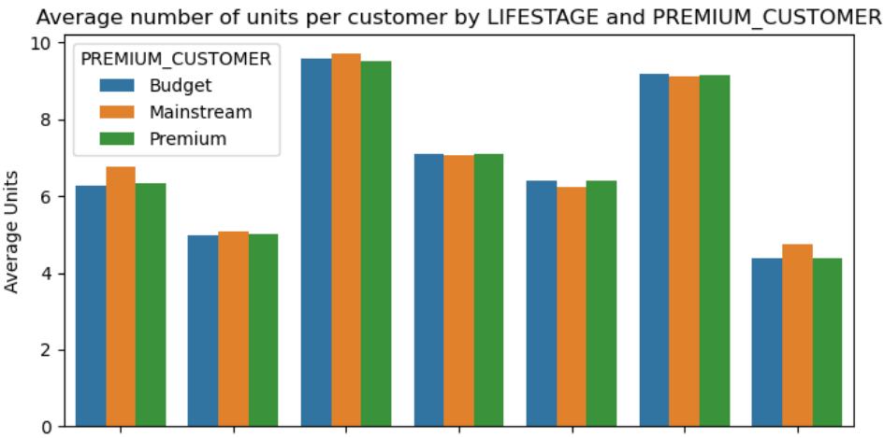
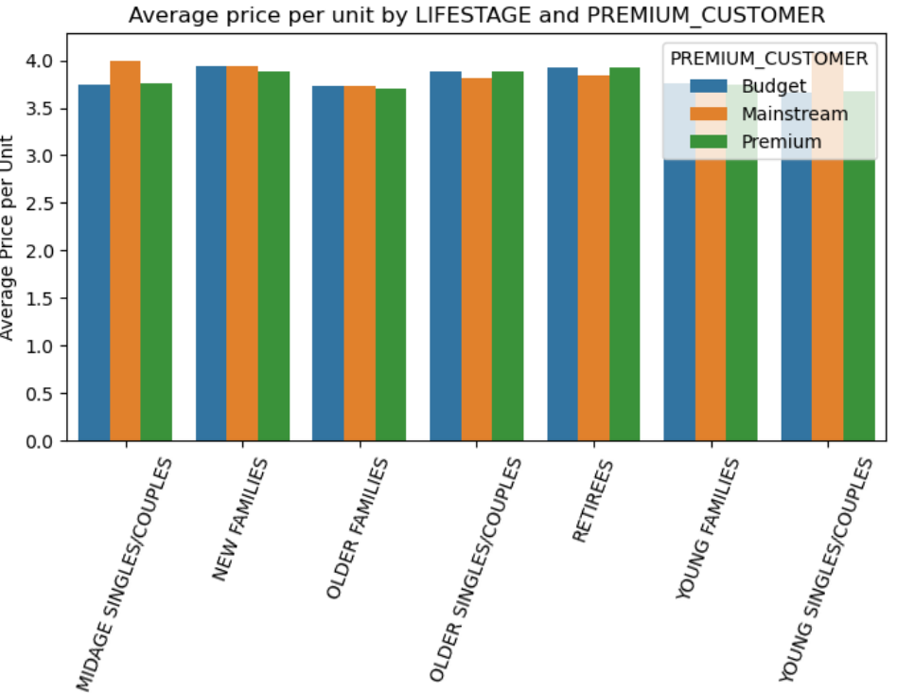
Purchase Behavior Analysis
Number of Customers by Segment:
Mainstream - young singles/couples and retirees show higher customer numbers, contributing to increased sales.
Budget - older families have fewer customers but still contribute significantly to sales due to higher purchase volumes.
Average Units per Customer:
Older families and young families generally buy more units of chips per customer.
Average Price per Unit:
Mainstream mid-age and young singles/couples are willing to pay more per packet of chips compared to their budget and premium counterparts.
Notes:
Analyzing customer purchasing behavior is critical for businesses in the chip sales market. By understanding the patterns and value of different customer segments, companies can implement targeted strategies to enhance customer lifetime value and ensure sustainable revenue streams.
Sales are coming mainly from Budget - older families, Mainstream - young singles/couples, and Mainstream- retirees
There are more Mainstream - young singles/couples and Mainstream - retirees who buy chips. This contributes to there being more sales to these customer segments but this is not a major driver for the Budget-Older families segment.
Older families and young families in general buy more chips per customer
Mainstream midage and young singles and couples are more willing to pay more per packet of chips compared to their budget and premium counterparts. This may be due to premium shoppers being more likely to buy healthy snacks and when they buy chips, this is mainly for entertainment purposes rather than their own consumption. This is also supported by there being fewer premium midage and young singles and couples buying chips compared to their mainstream counterparts

Slide 6

Brand affinity
Spending Patterns: Mainstream mid-age and young singles and couples are willing to pay more per packet of chips compared to their budget and premium counterparts.
Statistical Analysis:
An independent t-test was performed to check if the difference in average price per unit is statistically significant. The p-value was 0.0, indicating that the unit price for mainstream, young, and mid-age singles and couples is significantly higher than that for budget or premium, young, and mid-age singles and couples.
Brand Preferences:
Mainstream young singles and couples show specific brand affinities:
They are 23% more likely to purchase Tyrrells chips.
They are 56% less likely to purchase Burger Rings.
Pack Size Preferences:
Mainstream young singles and couples are 27% more likely to purchase 270g packs of chips.
Notes:
Spending Patterns: Mainstream midage and young singles and couples are willing to pay more per packet of chips compared to their budget and premium counterparts.
Reason: Premium shoppers often buy chips for entertainment rather than personal consumption, and tend to prefer healthy snacks.
Statistical Analysis:
An independent t-test was performed to check if the difference in average price per unit is statistically significant.
Result: The p-value was 0.0, indicating that the unit price for mainstream, young, and mid-age singles and couples is significantly higher than that for budget or premium, young, and mid-age singles and couples.
Brand Preferences:
Mainstream young singles and couples show specific brand affinities:
They are 23% more likely to purchase Tyrrells chips.
They are 56% less likely to purchase Burger Rings.
Pack Size Preferences:
Mainstream young singles and couples are 27% more likely to purchase 270g packs of chips.
Insight: The 270g packs are exclusively offered by the Twisties brand, suggesting a higher likelihood of purchasing Twisties among this segment.

Slide 7
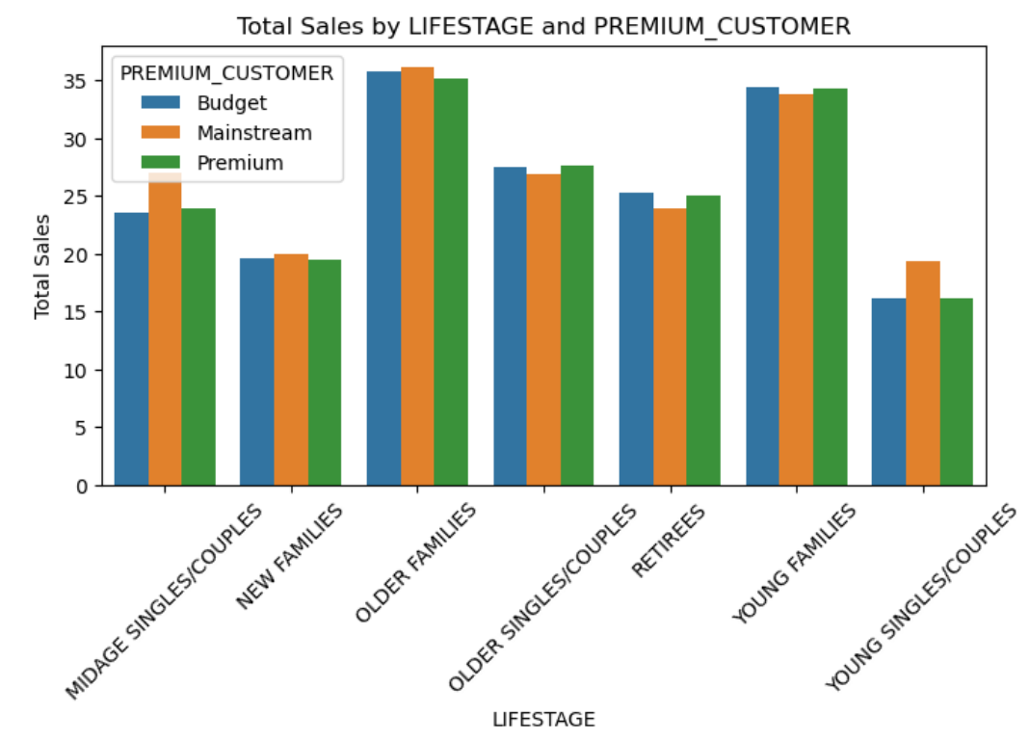
CUSTOMER LIFETIME VALUE(CLV)
Older Families and Young Families lead in total sales and quantities, suggesting they are the most valuable customer segments.
Minimal differences in purchasing behavior across Budget, Mainstream, and Premium statuses within Older and Young Families.
Notes:
Customer lifetime value analysis is crucial for long-term success in the chip sales market. By identifying key segments, understanding the importance of retention, and recognizing growth potential, businesses can align their strategies to optimize customer relationships and drive continuous revenue growth.
Older families and young families emerge as the primary drivers of total sales and quantities in the chip market, underscoring their importance as key customer segments with high potential for revenue generation and long-term profitability.

Slide 8
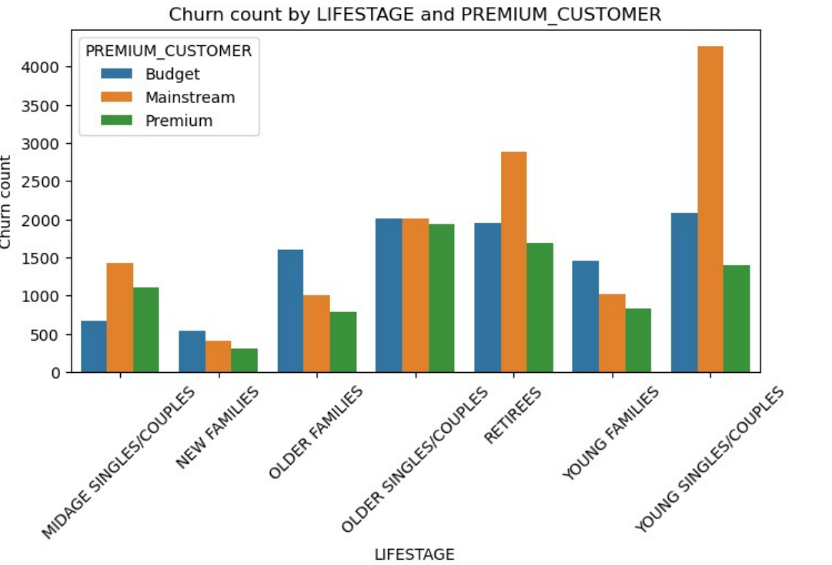
CHURN ANALYSIS
Young Singles/Couples: High churn rates indicate a need for targeted retention strategies.
Retirees: High churn, especially among Mainstream customers, suggests potential for improved engagement strategies for senior customers.
New and Young Families: Lower churn rates indicate effective retention or higher satisfaction levels.
Notes:
Young Singles/Couples have the highest churn rates, especially in the Mainstream category, indicating a need for targeted retention strategies.
Retirees show substantial churn, with Mainstream customers leading, suggesting potential for improved engagement with senior customers.
New and Young Families have comparatively lower churn rates, indicating better retention or satisfaction levels within these segments.

Slide 9
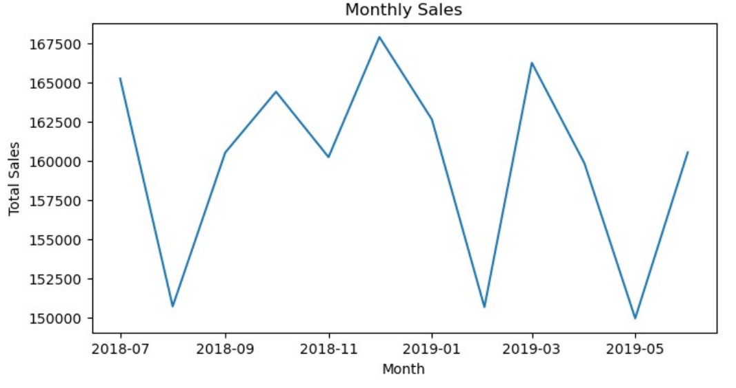
Seasonal Sales Analysis
Sales Fluctuation: Monthly sales fluctuate, indicating that customer purchasing behavior varies throughout the year.
Peak Sales in December: December shows a significant peak in sales, likely due to the holiday season.
Low Sales Periods in February and May: February and May experience the lowest sales, possibly due to post-holiday spending fatigue and pre-summer slowdowns.
Moderate Variability: While there are notable peaks and troughs, the overall variability in monthly sales is moderate.
Lack of Strong Seasonal Trend: Apart from the holiday season peak, there is no clear seasonal trend, suggesting other factors significantly influence sales.
Notes:
Identifying seasonal sales patterns and holiday season trends is key for success in the chip sales market.
The sales figures fluctuate month-to-month, indicating variability in customer purchasing behavior across different times of the year.
December 2018 shows the highest total sales (167,913.40), suggesting a potential seasonal peak during the holiday season.
February 2019 and May 2019 have the lowest total sales (150,645.50 and 149,923.95 respectively), indicating potential post-holiday and pre-summer lulls.
While there are peaks and troughs, the overall variability in monthly sales is moderate, with values ranging from around 149,924 to 167,913.
Aside from the holiday season peak, there is no strong, clear seasonal trend, indicating that other factors might also significantly influence monthly sales.

Slide 10
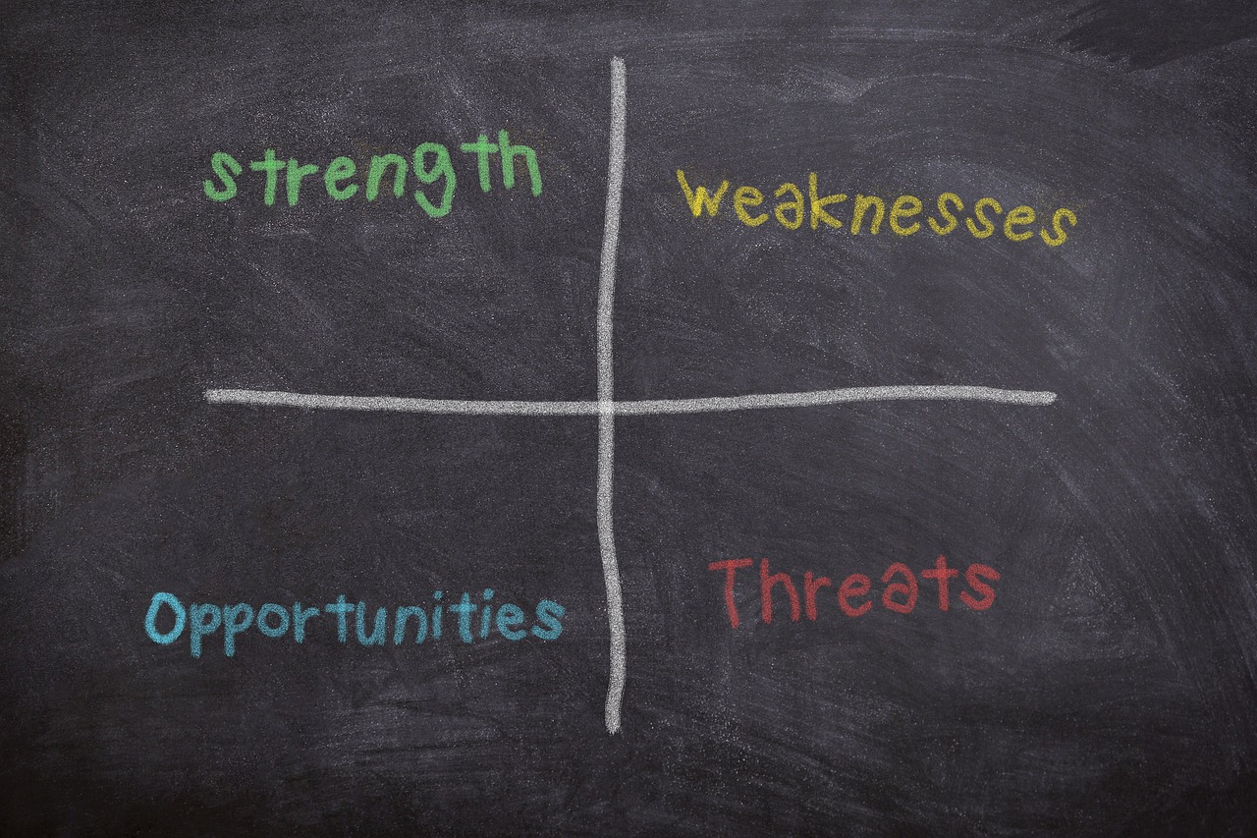
SWOT Analysis
• Strengths: High sales contribution from key segments; strong customer loyalty among older and young families.
• Weaknesses: High churn rates among young singles/couples and retirees.
• Opportunities: Targeted marketing to high-churn segments; capitalizing on seasonal trends to boost sales. For instance, targeting young singles/couples with personalized offers could reduce churn.
• Threats: Competition from healthier snack options; potential economic downturns affecting purchasing power.
This Photo by Unknown Author is licensed under CC BY-NC-ND
Notes:
Conducting a SWOT analysis is essential for strategic planning in the chip sales market. By evaluating strengths, weaknesses, opportunities, and threats, businesses can develop actionable strategies to capitalize on strengths, mitigate weaknesses, seize opportunities, and address potential threats for sustainable growth and success.

Slide 11

Timeline for strategic implementation
• Short-Term Strategies:
Launch exclusive offers and loyalty programs.
Start personalized email campaigns.
Launch social media campaigns.
Begin regular customer feedback collection.
• Mid-Term Focus:
Roll out engagement programs for Retirees.
Execute seasonal marketing campaigns.
Distribute educational content for Retirees.
Refine loyalty programs and retention strategies
• Long-Term Development:
Introduce new product bundles and convenience products.
Adjust strategies based on seasonal promotion effectiveness.
Enhance loyalty rewards.
Scale direct marketing for Retirees.
Notes:
Establishing a timeline for strategic implementation is essential for achieving business goals in the chip sales market. By setting short-term strategies, focusing on mid-term customer retention, and planning for long-term product development, businesses can create a roadmap for success and sustainable growth in a competitive market environment.
### Strategic Implementation Timeline
#### Short-Term Strategies (0-3 Months)
- **Exclusive Offers & Loyalty Programs:** Launch exclusive offers for Older Families and design loyalty programs for all segments.
- **Personalized Communication:** Start personalized email campaigns and develop engaging content for Young Families.
- **Social Media Campaigns:** Launch campaigns targeting Young Families and Mainstream Young Singles/Couples.
- **Customer Feedback:** Begin regular feedback collection.
#### Mid-Term Focus (4-9 Months)
- **Engagement Programs:** Roll out engagement programs for Retirees.
- **Community Building:** Establish online forums and social media groups for Mainstream Young Singles/Couples.
- **Seasonal Promotions:** Plan and execute marketing campaigns for peak and low sales periods.
- **Educational Content:** Distribute health and lifestyle content for Retirees.
- **Retention Strategies:** Refine loyalty programs and implement targeted retention strategies for high-churn segments.
#### Long-Term Development (10-18 Months)
- **Product Bundles & Convenience Products:** Introduce new product bundles for Older Families and expand convenience products for Young Families.
- **Seasonal Trends:** Analyze and adjust strategies based on seasonal promotion effectiveness.
- **Loyalty Rewards:** Enhance loyalty rewards based on customer engagement.
- **Direct Marketing:** Scale direct mail and phone marketing for Retirees.

Slide 12

Summary
Key Strategies
Customer Segmentation: Target Older Families, Young Families, Mainstream Young Singles/Couples, and Retirees.
Exclusive Offers & Loyalty Programs: Tailor offers and rewards for high-value segments.
-Personalized Communication & Social Media: Engage through personalized emails and social media campaigns.
Customer Feedback: Collect and act on feedback regularly.
Implementation Timeline
Short-Term (0-3 Months): Finalize segmentation, launch offers, start personalized emails, and collect feedback.
Mid-Term (4-9 Months): Implement engagement programs, enhance data analytics, build online communities, and execute seasonal promotions.
Long-Term (10-18 Months):Introduce new bundles, adjust strategies, enhance rewards, scale direct marketing, host events, and optimize retention.
Focusing on these strategies and following the timeline will improve customer satisfaction, boost sales, and enhance loyalty.
Notes:
Exploring investment potential in the chip sales market requires a comprehensive understanding of data-driven insights, strategic recommendations, and a well-defined timeline for implementation.
Key Strategies
Customer Segmentation: Focus on Older Families, Young Families, Mainstream Young Singles/Couples, and Retirees.
Exclusive Offers & Loyalty Programs: Target high-value segments with tailored offers and rewards.
Personalized Communication & Social Media: Engage segments through personalized emails and social media campaigns.
Customer Feedback: Regularly collect and act on customer feedback.
Implementation Timeline
Short-Term (0-3 Months)
Finalize segmentation.
Launch exclusive offers and loyalty programs.
Start personalized email campaigns.
Launch social media campaigns.
Begin feedback collection.
Mid-Term (4-9 Months)
Implement engagement programs for Retirees.
Enhance data analytics and A/B testing.
Establish online communities.
Execute seasonal promotions.
Distribute educational content.
Refine loyalty and retention strategies.
Long-Term (10-18 Months)
Introduce new product bundles and convenience products.
Adjust seasonal strategies.
Enhance loyalty rewards.
Scale direct marketing.
Host engagement events.
Optimize long-term retention plans.
By focusing on these strategies and following the timeline, you can improve customer satisfaction, boost sales, and enhance customer loyalty across key segments.

Slide 13

Thank you!
Connect via:
Email: rupsachaudhuri9@gmail.com
LinkedIn
GitHub

